Slide 1
“Production Management System” for “Studio Sunna”
Course Name: System Analysis & Design
Course code: CSC 387
Group code: C7
Group Name: Team Debugger

Slide 2

GROUP DETAILS
Sl no. | Name | ID | E-mail
1 | Md. Erfan Ullah Bhuiyan (Leader) | 15103325 | mderfan2@gmail.com
2 | Fardina Sultana | 15103337 | 15103337@iubat.edu
3 | Md. Ashfaq Uddin | 15103341 | 15103341@iubat.edu
4 | Sadia Islam | 15103363 | 15103363@iubat.edu
Prepared For
Md. Saidur Rahman
Senior Lecturer of Department of Computer Science and Engineering
International University of Business Agriculture and Technology
Uttara, Dhaka-1230

Slide 3
INTRODUCTION
This project is mainly developed for the project requirement of course CSC 387 of IUBAT University to ensure the development skill of knowledge.
The purpose is to keep the record of clients, products, sales, orders of Studio Sunna. Updating information is also possible in this software.
Overall, consumption of time and energy, better security are the main aim of this project.

Slide 4
Aim of project
In the existing system the storing data is done only manually paper-pan based system.
But in our proposed system we have to computerize all the processing information using the Product Management System.
All sort of information is managed by an admin and that is the reason of our main system.

Slide 5
Problems with Existing System
Lack of security of data.
More man power.
Time consuming.
Needs manual calculations.
No direct role for the higher officials.
Possibility to Lost of information.

Slide 6
Advantage of the Proposed System
Security of data
Ensure data accuracy.
Proper control of the higher officials.
Minimize manual data entry.
Minimum time needed for the various processing.
Greater efficiency.
Better service.
User friendliness and interactive.
Minimum time consumption.

Slide 7
PROPOSED SYSTEM DESIGN
Logical design:
We have reviewed the current physical system - its data flows, file content, volumes, frequencies etc of Sunna Studio.
Then we prepared output specifications which determine the format, content and frequency of reports.
Then prepared input specifications -format, content and most of the input functions.
After that we prepared edit, security and control specifications.
Finishing the four steps we started for the implementation plan.
So, we prepared a logical design walk through of the information flow, output, input, controls and implementation plan.
Finally we reviewed benefits, costs, target dates and system constraints.

Slide 8
PROPOSED SYSTEM DESIGN
Physical design:
Designing the physical design for the system.
We specified input and output media.
Then designed the database and specified backup procedures.
We designed physical information flow through the system and a physical design walk through.
We planned the system implementation.
After that we determined training procedures, courses and timetable for the system.
After a test and implementation plan we specified any new hardware/software if needed.
Finally we updated benefits, costs, and conversion date and system constraints.

Slide 9
Entity Relationship Diagram
Entity of our system:
User
Client
product
Order List
Sales Record

Slide 10
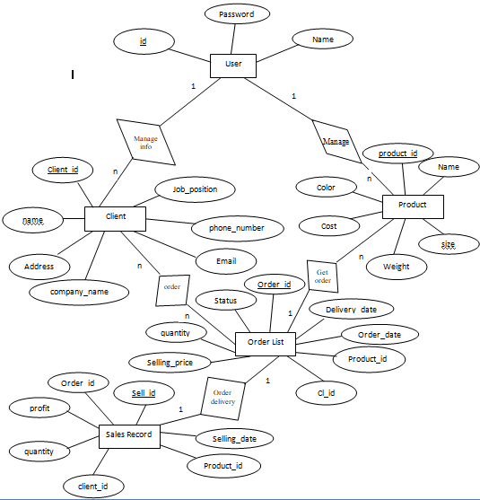
Entity Relationship Diagram

Slide 11
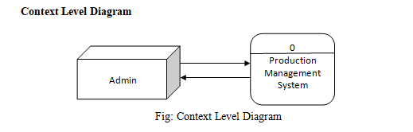
DFD of Project

Slide 12
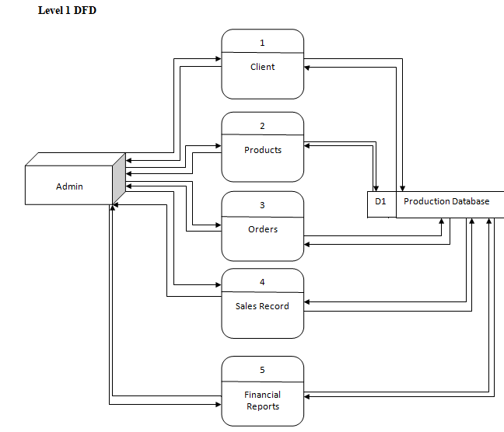
DFD of Project

Slide 13
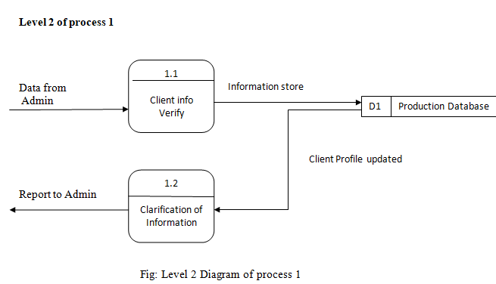
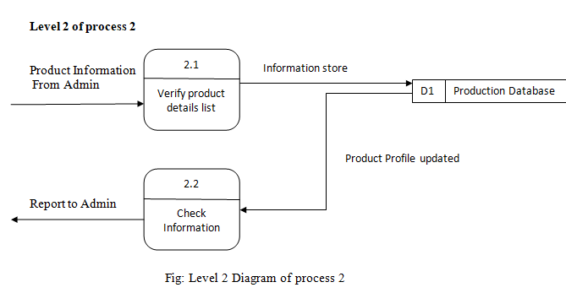
DFD of Project

Slide 14
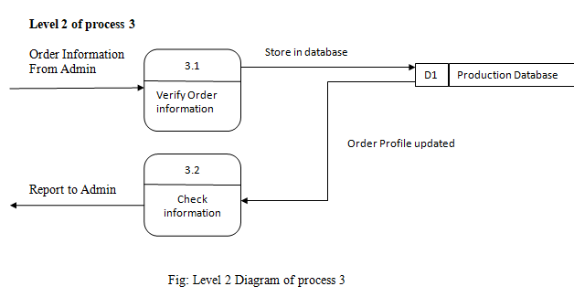
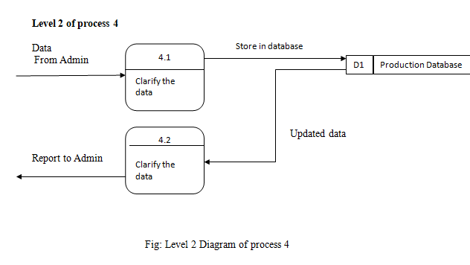
DFD of Project

Slide 15
Effort Distribution

Slide 16
Effort Distribution

Slide 17
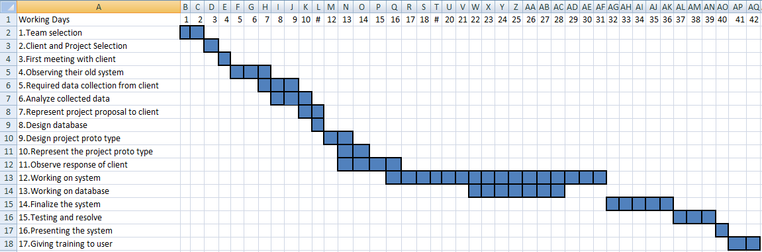
Time Chart for Activities

Slide 18
Project Cost Estimation
Hardware Costs
Hardware Accessories Cost= 30900 tk
Hardware Accessories life= 36 Months
Hardware Accessories usage = 4 Months
Hardware Accessories use cost = (30900/36) *4 = 3433 tk

Slide 19
Project Cost Estimation
Software Costs
Legal Licensed Software for system development:
Software Cost= 115 200 tk
Software licensed Validity= 12 Months
Software usage = 4 Months
Software use cost = (115200/12)*4 = 38400 tk
Total Software cost 38400 tk

Slide 20
Project Cost Estimation
Total Estimation:
To develop this project the estimated cost is:
Hardware Cost: 3433 tk
Software Cost: 38400 tk
Others Cost: 8000 tk
Total: 49833 tk

Slide 21
System Testing
There are three ways to test program.
For correctness
For implementation efficiency
For computational complexity
The levels of testing include:
Validation Testing
Unit Testing
Integration Testing
Output Testing

Slide 22
System Requirements
Hardware Requirements
Mother Board : Intel Pentium D
Processor : 1.0 GH7 Clock speed
RAM : 512 MB or more
Hard disk : 20 GB or more
Monitor : VGA/SVGA
Keyboard : 11:4 Keys
Mouse : 2 buttons/ 3 buttons

Slide 23
System Requirements
Software Requirements
Operating System : Windows 98/2000/XP/Vista/Windows 7
Front-end : Visual Basic 6.0
Back-end : MS Access / MS SQL Server
Report : Crystal Report 9.0

Slide 24
Using Guideline
Training Session:
For training purpose, we planned to make it familiar for the user. In this way it can be much easier to use and maintain.
Training:
To make training where several topics included for the administrators which are, how to use, data backup, security arrangement, we will show the user how to use this Product Management System.

Slide 25
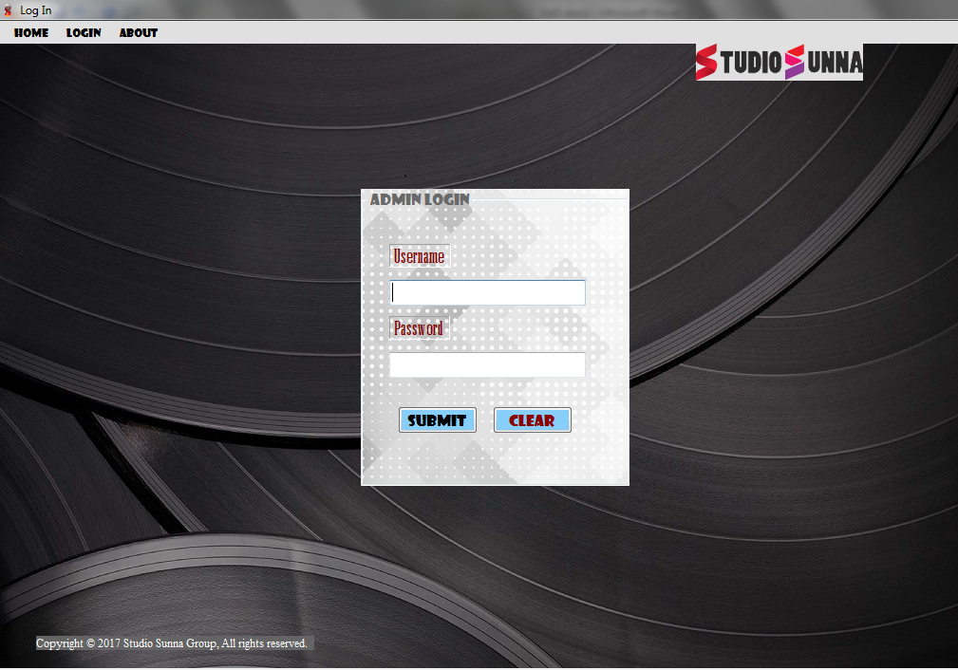
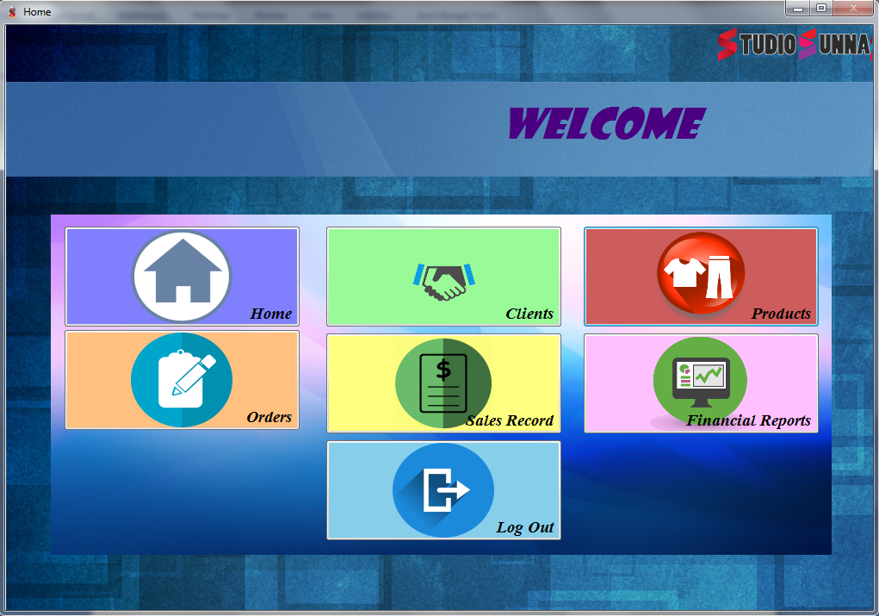
Screen Shoot of project

Slide 26
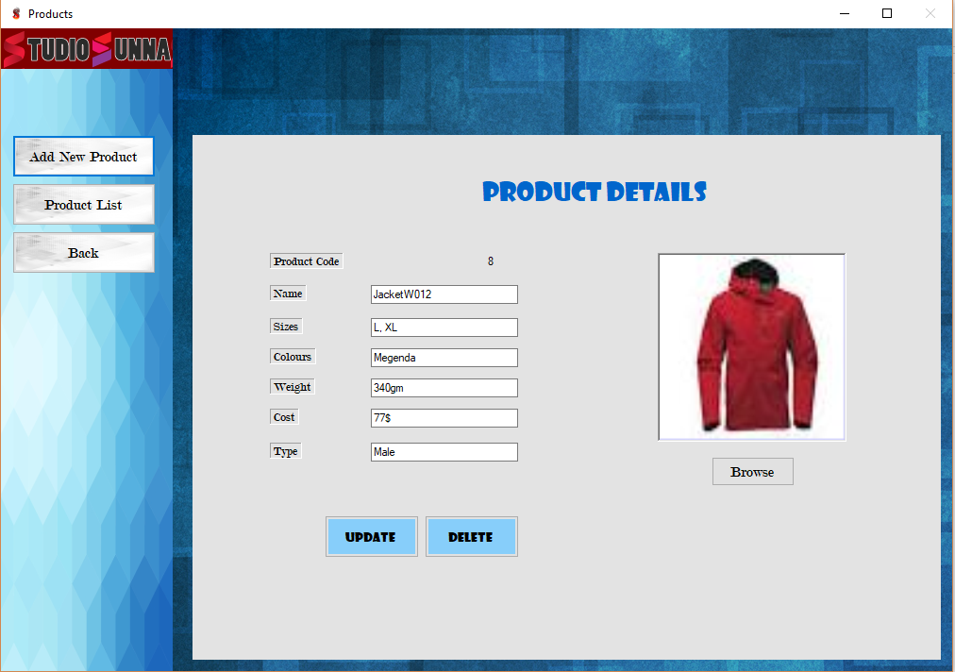
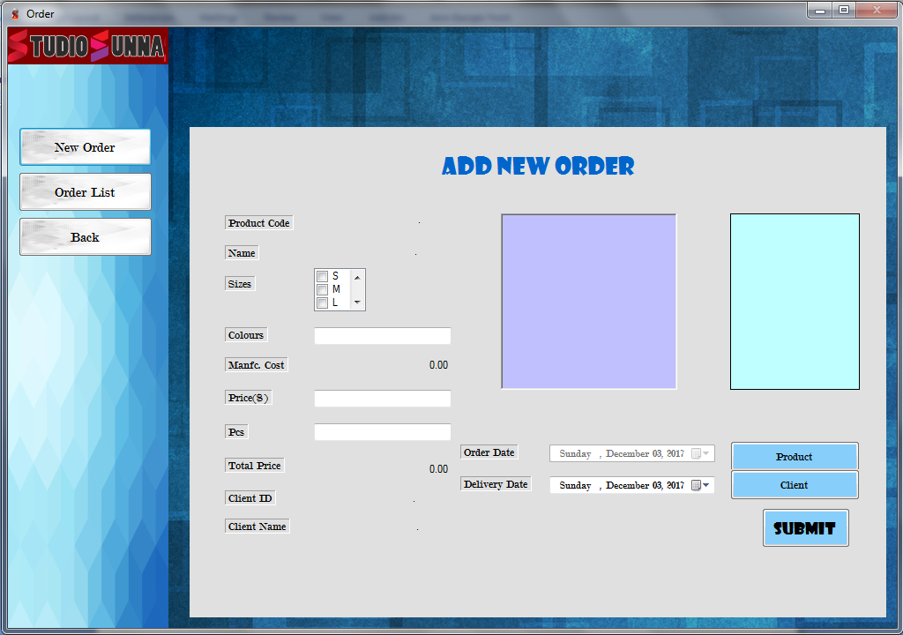
Screen Shoot of project

Slide 27
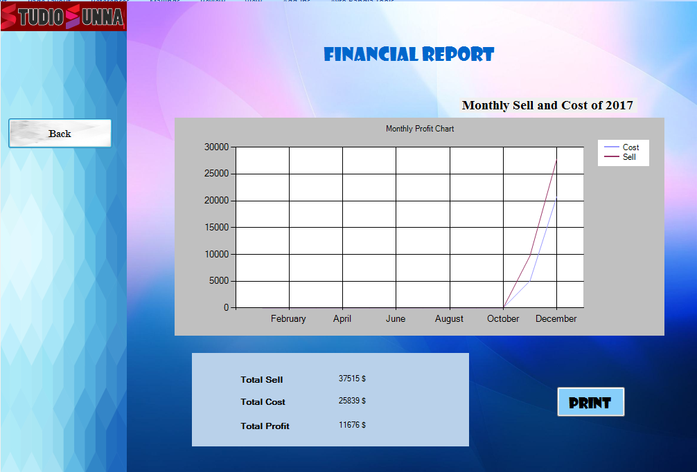
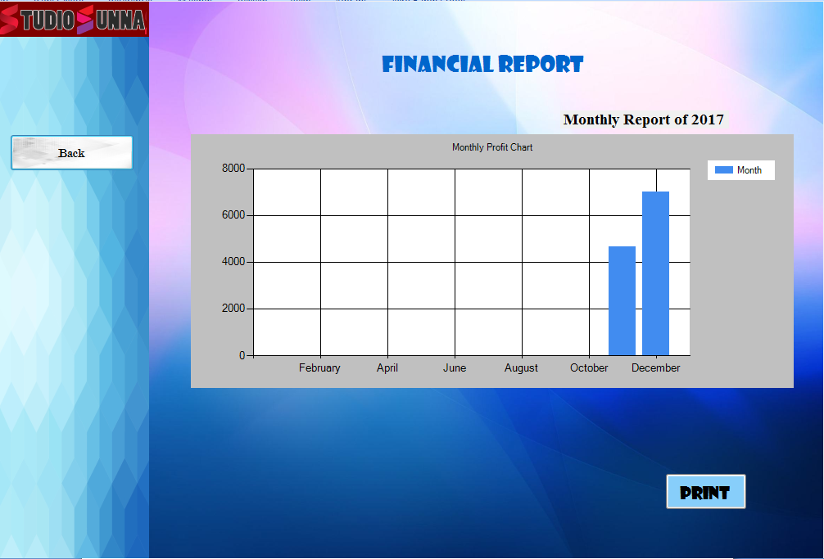
Screen Shoot of project

Slide 28
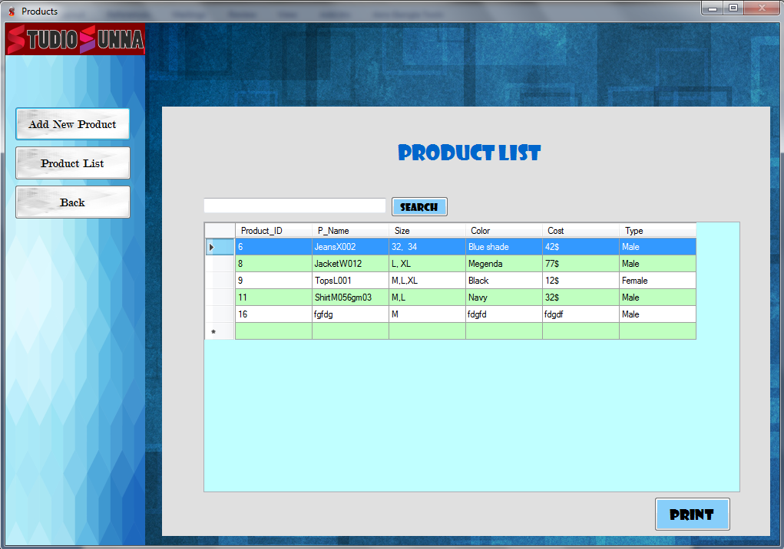
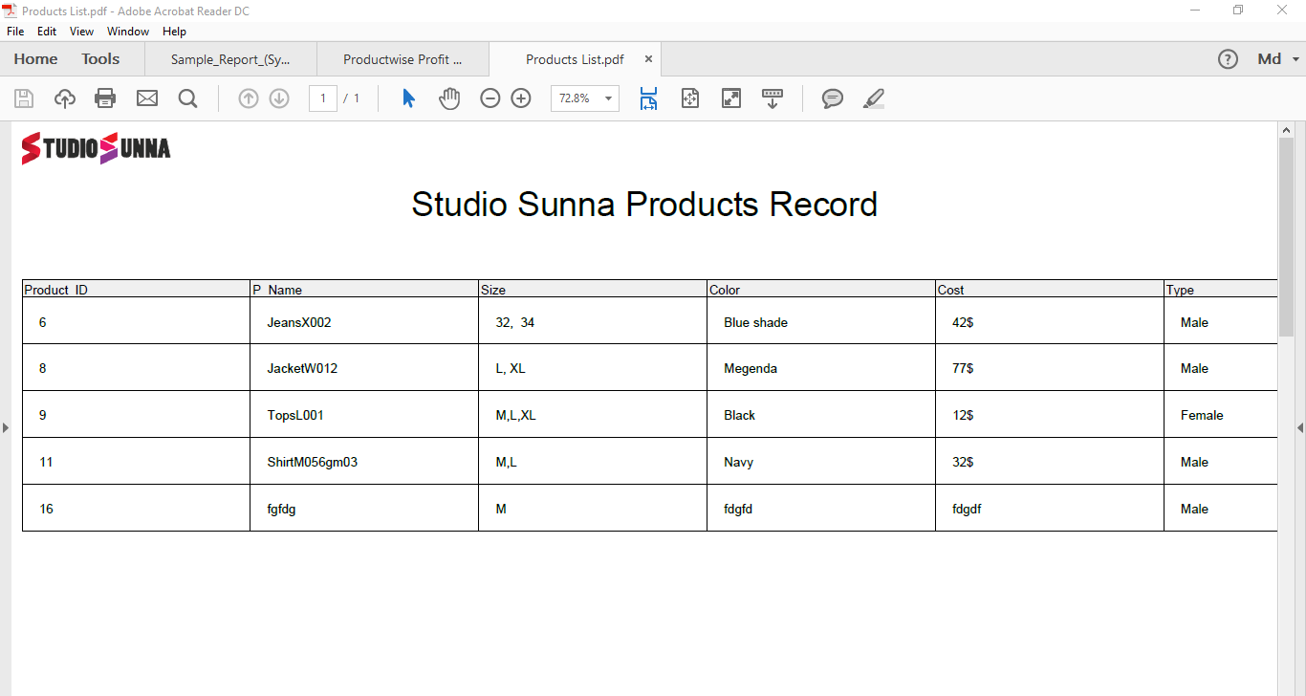
Screen Shoot of project

Slide 29
Conclusion
"Product Management System" keeps the day by day record.
It can keep the information of clients, products, sales, financial records.
It can visualized all the financial state in a better way.
It can consume time as well as energy.
We have tried our best to create a useful system for Studio Sunna.

